Slide 1
Using Mobile Computers
Lesson 12

Slide 2
Objectives
Understand wireless security
Configure wireless networking
Use Windows mobility controls
Synchronize data
Use BitLocker Drive Encryption
Use remote network connections
Notes:
Outline the material you are going to cover in this lesson. Do not go into detail as each of these points will be expanded on in the lesson. You may also want to mention the Technology Skills that are being covered for the Certification exam also.

Slide 3
Using Windows 7 on a Mobile Computer
Special configuration settings
  Power and display options
Windows 7 supports tablet PCs
  Reversible screen, touch sensitive, write on with a stylus
Handheld devices, such as SmartPhones, need to be synchronized
Notes:
Introduce the concept of mobile computers/laptops and handheld devices and that there are settings that are particularly important for these devices.

Slide 4
Understanding Wireless Security
Easy to establish a wireless connection, but a secure one is more difficult. Some types of attacks common to unsecured networks:
  Eavesdropping
  Masquerading
  Attacks against wireless clients
  Denial of service
  Data tampering
Notes:
Discuss the types of attacks that can occur on a wireless network.

Slide 5
Evaluating Wireless Networking Hardware
IEEE 802.11 standards dictate frequencies, transmission speeds, and ranges of wireless networking products.
Newer devices can fall back to support older devices at lower speeds.
Security protocols are not backward compatible:
  Wired Equivalent Privacy (WEP)
  WiFi Protected Access (WPA and WPA2)
Notes:
Talk about backward compatibility with devices. Refer to the table 12-1 in the textbook to show speeds of the different wireless standards. Discuss the security protocols and that WEP has been around for a while and is supported by most devices, while WPA and WPA2 are more recent and are not supported by some older devices.

Slide 6
Using Wired Equivalent Privacy (WEP)
Uses a security setting to encrypt network traffic – Secret or shared key
Administrators must configure all devices with the same shared secret key
Relatively weak cryptography
Authentication methods;
  Open system
  Shared Key
Better to used the open system.
Notes:
Describe WEP and some of the disadvantages of using WEP.

Slide 7
Using Wi-Fi Protected Access
(WPA and WPA2)
Addresses the weakness of WEP
Two encryption options:
  Temporal Key Integrity Protocol (TKIP)
  Advanced Encryption System (AES)
WPA has two operational modes:
  WPA-Personal (WPA-PSK)
  WPA-Enterprise (WPA-RADIUS)
Notes:
Explain WPA and its features.

Slide 8
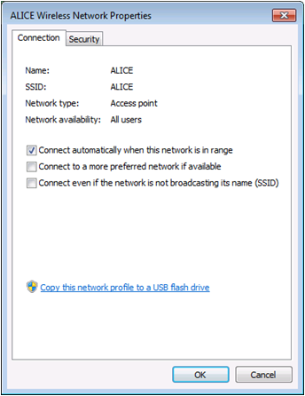
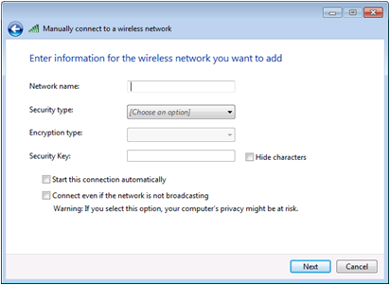
Configuring Wireless Networking
Manual configuration for wireless adapters that are supported directly by Windows 7
Notes:
Explain the process of configuring a wireless adapter using the screens above. Note that if the adapter includes its own configuration software, it should be used before you can configure the adapter through Windows 7.

Slide 9
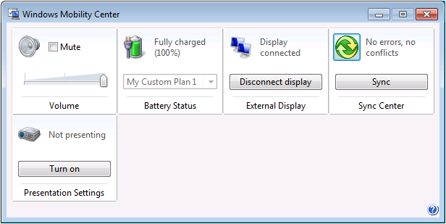
Windows Mobility Center
Provides quick access to configuration settings used by mobile computer users
Notes:
Introduce the Windows Mobility Center. Explain the 8 tiles that can appear, but it depends on the type of computer you’re using, which tiles appear.

Slide 10
Configuring Mobile Display Options
One of the benefits of mobile computing is the ability to collaborate with others.
Display configurations are often changed to accommodate viewing:
  Connecting an external display
  Configuring multiple displays
  Using a display projector
Notes:
Discuss why users would often want to configure display settings, and describe the different configurations.

Slide 11
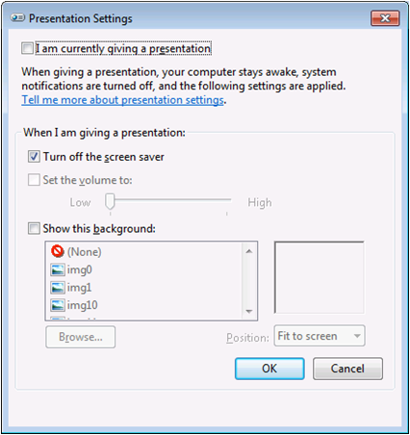
Configuring Presentation Settings
Configuration settings that users most often adjust before giving a presentation
Notes:
Discuss what types of unexpected events can occur during a presentation. Refer to the screen shot to explain the settings a presenter might want to alter before doing a presentation.

Slide 12
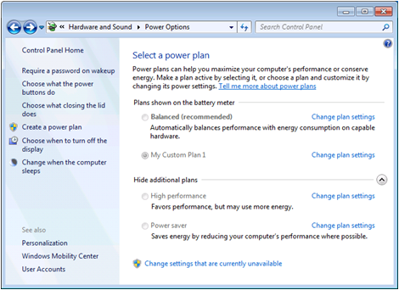
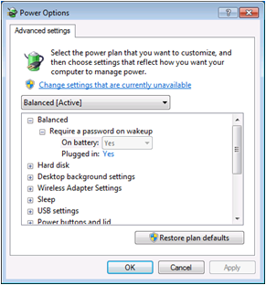
Configuring Power Options
Power consumption is a critical issue for laptop users who rely on batteries.
Notes:
Discuss the importance of configuring power options for laptop users who rely on batteries. Explain that battery power can be monitored, power plans can be selected and customized to meet any user’s requirements. Group Policy can be used in an AD DS to configure power options. Powercfg.exe is a command line program that is very comprehensive. Can be used to export entire power management plans to a file that then can be imported on another computer.

Slide 13
Synchronizing Data
For users who connect to a network when in the office and need to take files with them when they are not connected
Two types of synchronization:
  One-way
  Two-way
Notes:
Introduce the concept of data synchronization and describe the two types.

Slide 14
Using Offline Files
A form of fault tolerance
Workstations copy server-based folders to the local drive
Users can work with the files whether the network is operational or not, or even if they disconnect from the network
When the workstation reconnects, synchronization of the files occurs
Notes:
Introduce Offline Files and describe the synchronization process. Make sure to note that if both files have changed the user is prompted to choose which file is saved. Shares can be configured to not allow Offline Files. Group Policy can also be used to control Offline Files in an AD DS.

Slide 15
Transparent Caching
Causes Windows 7 to save copies of files accessed on a remote server on a local drive
Do not remain available when disconnected from the network
Provides users with faster repeat access and conserves bandwidth
Similar to BranchCache feature, except cached files are not shared with other workstations
Notes:
Explain Transparent Caching and how it is different from Offline Files and similar to BranchCache.

Slide 16
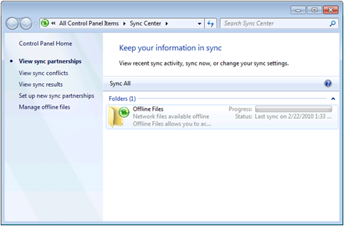
Using Sync Center
Central control panel for all synchronization partnerships
Pairs of folders or devices are configured to synchronize their data on a regular basis
Notes:
Describe the purpose of the Sync Center and how it works. Explain that you select what will be synchronized and you create a schedule.

Slide 17
Using BitLocker
First released in Vista, and now available with Windows 7 Enterprise and Ultimate
Encrypts an entire volume to protect against unauthorized persons, such as someone stealing a hard drive:
  Increased data protection
  Integrity checking
Notes:
Introduce BitLocker Drive Encryption.

Slide 18
Understanding BitLocker Requirements
Computer must have a Trusted Platform Module (TPM) and a compatible BIOS.
Has 5 operational modes:
  TPM + startup PIN + startup key
  TPM + startup key
  TPM + startup PIN
  Startup key only
  TPM only
Notes:
Describe the BitLocker requirements and the 5 operational modes which control the degree of security.

Slide 19
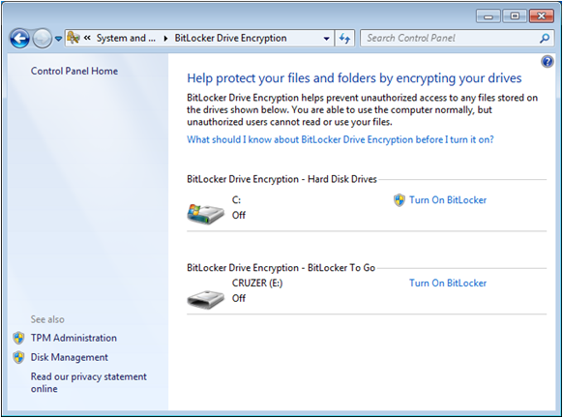
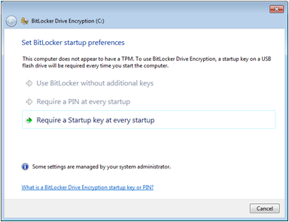
Turning on BitLocker
Notes:
BitLocker can run without a TPM chip, but it must be configured in Group Policy. The above screen shows how you turn BitLocker ON or OFF with no TPM chip.

Slide 20
Using Data Recovery Agents (DRA)
A user account authorized to recover BitLocker drives with a digital certificate on a Smart Card
Must be configured using Group Policy in an AD DS
Must enable DRA recovery for each type of BitLocker resource you want to recover
Notes:
Explain DRA.

Slide 21
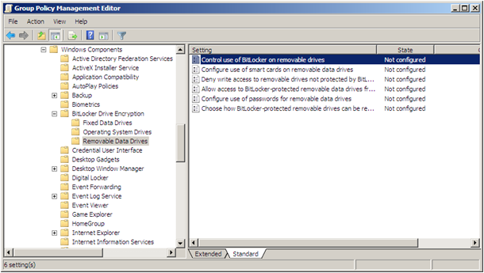
Using BitLocker To Go
New feature in Windows 7
Enables user to encrypt removable USB drives – Flash drives and external HDs
Notes:
Note that removable drives could always be encrypted, but BitLocker To Go enables you to use the encrypted device on other computers without having to perform a recovery process. Settings are controlled through Group Policy. Explain the settings shown on the screen.

Slide 22
Using Remote Network Connections
For travelling or telecommuting users who must connect to the company network from a remote site:
  Dial-up
  Virtual Private Networking (VPN)
  Direct Access (new)
Notes:
Introduce the use of Remote Network Connections.

Slide 23
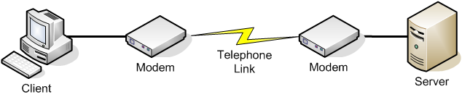
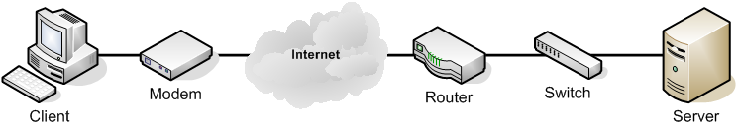
Understanding Virtual Private Networking
Dial-up Connection – Point-to-Point Protocol (PPP)
Virtual Private Network (VPN) - tunneling
Notes:
Use the notes in the text book and the diagrams on the slides to compare how dial-up and VPN work.

Slide 24
VPN Protocol Encapsulation
Point-to-Point Tunneling Protocol (PPTP)
Layer 2 Tunneling Protocol (L2TP)
Secure Socket Tunneling Protocol (SSTP)
Internet Key Exchange, Version 2 (IKEv2)
Notes:
Describe how tunneling re-encapsulates the user’s data and briefly describe each VPN protocol supported by Server 2008.

Slide 25
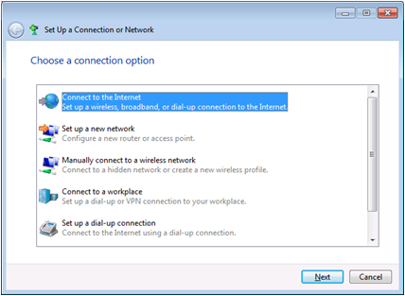
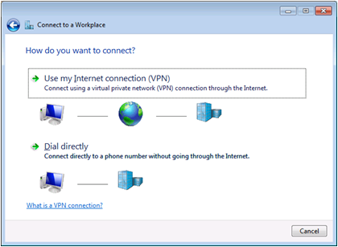
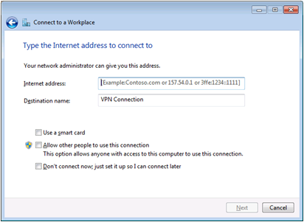
Creating a VPN Connection
Notes:
Describe the process of creating a VPN connections using the screen shots on the slide. Additionally, the user will be prompted to enter their username and password.

Slide 26
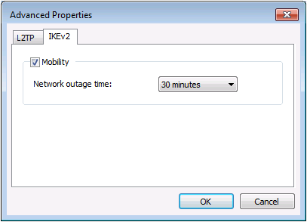
Using VPN Reconnect
When a VPN was interrupted, users had to manually re-establish the connection.
Wireless has made this more of a problem.
VPN Reconnect enables a computer to reconnect automatically.
Notes:
Describe the NEW feature, VPN Reconnect.

Slide 27
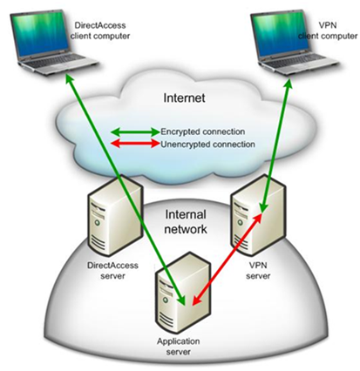
Introducing DirectAccess
Replacement for VPN
Eliminates the need for clients to manually establish wide area connections to their networks
Automatically connects to the network when connected to the Internet
Notes:
Introduce DirectAccess and how it was created so that users who can not handle the complicated task of connecting to a remote network, no longer have to. DirectAccess simplifies the process for the user and puts the burden of configuration on the administrators. Discuss some of the other benefits of DirectAccess.

Slide 28
Understanding the DirectAccess Infrastructure
Invisible to the client, but complicated communications process with a long list of back-end infrastructure requirements:
  IPV6 – Globally routable addresses
  Ipsec – Provides additional security
  Extensive Server requirements
  Clients running Windows 7 Ultimate or Enterprise or Server 2008 R2, in the same domain as the DirectAccess Server
Notes:
Briefly explain the extensive requirements for setting up DirectAccess.

Slide 29
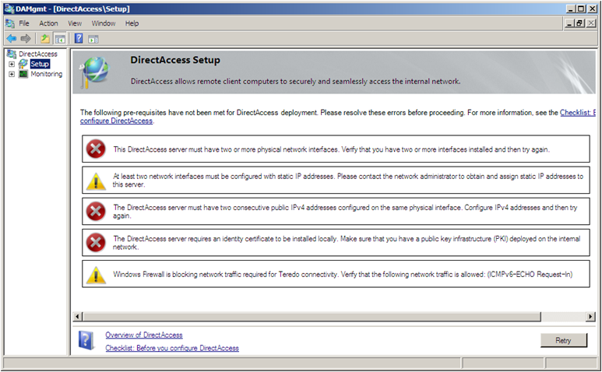
DirectAccess Setup
Notes:
Note the prerequisite check for Server 2008 R2 on the screen shot.

Slide 30
Skills Summary
Windows Mobility Center is a shell application that provides a central point of access to configuration settings that mobile computer users need.
Configuring external displays is a common task for mobile computer users.
Power settings allow you to control the power consumption of components in your mobile device.
Offline files store copies of network files on the local drive, for use when the computer is disconnected.
Notes:
Review the Skill Summary to wrap up your lesson.

Slide 31
Skills Summary (cont.)
Sync Center is a central control panel for all of the synchronization partnerships.
BitLocker encrypts all of the files on a volume and performs an integrity check before it permits the system to start.
Dial-up or virtual private network (VPN) connections enable users to connect to a network from remote locations.
DirectAccess simplifies the remote connection process for inexperienced users.

